Slide 1
Exception

Slide 2

Learning Objectives Exception
Introduction
Exception Hierarchy
Difference between Exception & Error
Exception handling using : try-catch-finally
Checked and Unchecked exceptions
Multiple catch blocks.
Nested try blocks
User defined exceptions (Customized Exceptions)
Throw and Throws

Slide 3
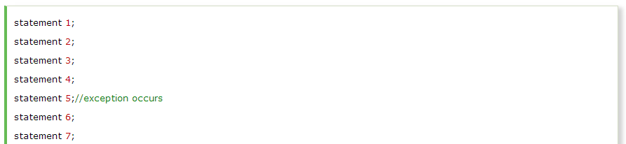
Introduction
The exception handling in java is one of the powerful mechanism to handle the runtime errors so that normal flow of the application can be maintained.
Advantage of Exception Handling
The core advantage of exception handling is to maintain the normal flow of the application. Exception normally disrupts the normal flow of the application that is why we use exception handling. Let's take a scenario:
Suppose there is 7 statements in your program and there occurs an exception at statement 5, rest of the code will not be executed i.e. statement 6 to 7 will not run. If we perform exception handling, rest of the statement will be executed. That is why we use exception handling in java.

Slide 4
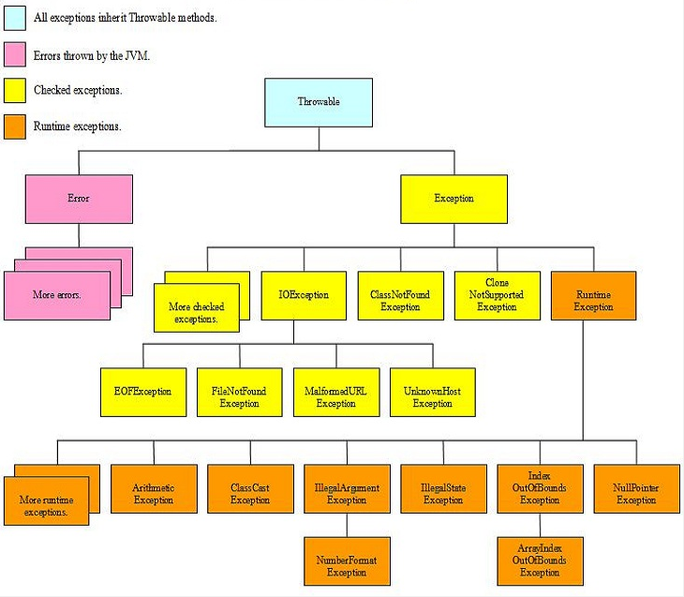
Exception Hierarchy

Slide 5
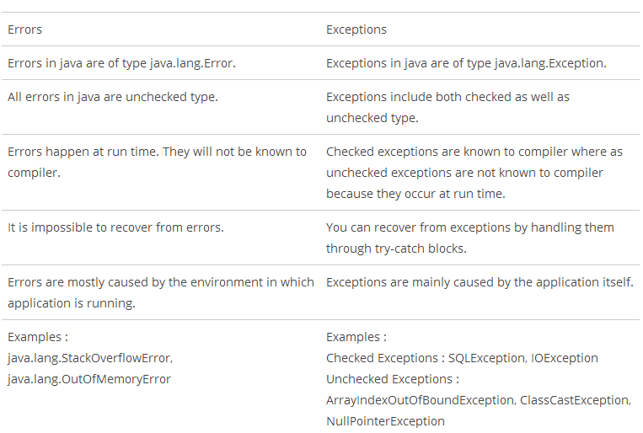
Error and Exception

Slide 6
Exception Handling
try-catch – We use try-catch block for exception handling in our code. try is the start of the block and catch is at the end of try block to handle the exceptions. We can have multiple catch blocks with a try and try-catch block can be nested also. catch block requires a parameter that should be of type Exception.
finally – finally block is optional and can be used only with try-catch block. Since exception halts the process of execution, we might have some resources open that will not get closed, so we can use finally block. finally block gets executed always, whether exception occurred or not.

Slide 7
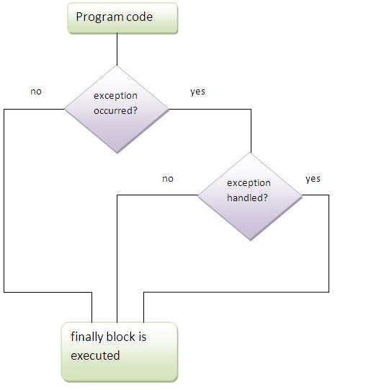
Exception Handling Contd.
Case 1 Exception doesn't occur.
Case 2 Exception occur and not handled
Case 3 Exception Occur and Handled

Slide 8
Checked and Unchecked Exception
Checked: are the exceptions that are checked at compile time. If some code within a method throws a checked exception, then the method must either handle the exception or it must specify the exception using throws keyword.
Unchecked: are the exceptions that are not checked at compiled time. In C++, all exceptions are unchecked, so it is not forced by the compiler to either handle or specify the exception. It is up to the programmers to be civilized, and specify or catch the exceptions.

Slide 9
Multiple Catch
If you have to perform different tasks at the occurrence of different Exceptions, use java multi catch block.
Rules
At a time only one Exception is occurred and at a time only one catch block is executed.
All catch blocks must be ordered from most specific to most general i.e. catch for ArithmeticException must come before catch for Exception .

Slide 10
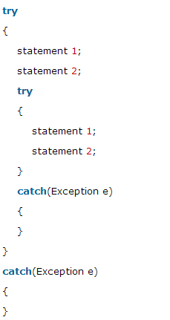
Nested Try Catch
The try block within a try block is known as nested try block in java.
Why use nested try block
Sometimes a situation may arise where a part of a block may cause one error and the entire block itself may cause another error. In such cases, exception handlers have to be nested.

Slide 11
User Defined Exception
If you are creating your own Exception that is known as custom exception or user-defined exception. Java custom exceptions are used to customize the exception according to user need.
Reason for use of Custom Exception
Existing exceptions class may not be suitable for your situation. By creating your own exception you can make it easier to understand why the exception is thrown and it will stand out better than if you were using an existing exception.

Slide 12
Throw and Throws
Throw
Java throw keyword is used to explicitly throw an exception.
We can throw either checked or uncheked exception in java by throw keyword.
Syntax
throw exception;
Throws
Java throws keyword is used to declare an exception. It gives an information to the programmer that there may occur an exception so it is better for the programmer to provide the exception handling code so that normal flow can be maintained.

Slide 13
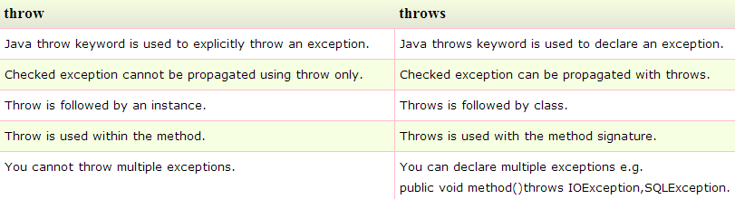
Throw and Throws
Syntax
return_type method_name() throws exception_class_name{
//method code
}

Slide 14
What are we learning in Next Chapter ?
Object class
String
StringBuffer & StringBuilder
Wrapper classes
Autoboxing and Unboxing

Slide 15
Thank You !

